Slide 1


Presents
Workshop on Generative AI
The Text aspects

Slide 2
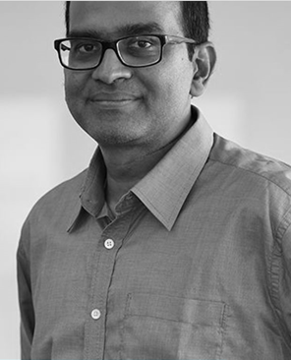
Faculty: Dr. Dakshinamurthy V Kolluru
Role
Founder CEO, upGrad INSOFE, TuringMinds and upGradLabs
Academic
Ph.D. & M.S. and in Material Science and Engineering from Carnegie Mellon Univ., USA,
B.E. in Metallurgical Engg., NIT Trichy, India.
Research interests
NLP
AI adoption
2

Slide 3

Agenda
Goal is to learn State-of-the-art Generative AI from a text analysis perspective
What is a Generative Model
What is Deep Learning
Text representations for models
Traditional Language models
Large Neural Generative Language Models
ChatGPT refinements
No prompt Engineering!

Slide 4

01
What is a Generative model?

Slide 5
Current Nomenclature for the M/L Tasks
Intelligence that can be achieved by digital technologies
Prediction of nature, future behavior or a value Classification/Regression
Learning insights from data
Clustering/Recommendations
Finding the best arrangement
Optimization/Reinforcement Learning
Learning to generate data
Gen AI
5
Notes:
Progressive, SA

Slide 6
Machine learning
Are you predicting a future value or behavior from the past
Supervised
If the output is number, regression
If the output is a category, classification
Are you figuring out best possible action?
When past knowledge is perfectly defined, optimization
Are you finding a pattern in the data
Unsupervised
Are you generating a new piece of data from old data?
Semi Supervised
When knowledge is ill-defined and requires trial and error, it is called reinforcement learning
When finding the influence of one entity on the other, recommendations
When grouping entities, clustering
Gen AI
If future is predicted based on past values of the same, time series
If a value is predicted based on influencing features, causal
If there is a dominant category, anomaly detection

Slide 7
Predicting oil price
# | Gold Price | Silver Price | Hints of war on twitter | Press releases from oil firms | Final result
1 | 26 | 120 |  |  | No spike
2 | 35 | 240 |  |  | Spike
Silver Price
Gold Price
7

Slide 8
How Algorithms Work?: Classification
Spike
Spike
No spike
No spike
Silver
Silver
Gold
Gold
Logistic Regression
Decision Trees
8

Slide 9
Limitation of Discriminative Models: It cannot generate new samples
9

Slide 10


Another Strategy: Generative
Spike
No spike
Silver
Gold
Naïve Bayes
10

Slide 11
02
Deep Learning
In 3 slides

Slide 12
Let us solve a few problems
What factors do you think impact global oil price?
What factors do you think you are using to recognize your daughter/son?

Slide 13
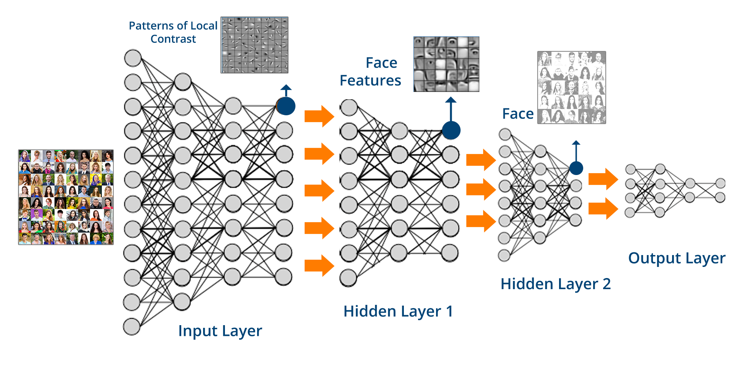
How DL helps?

Slide 14
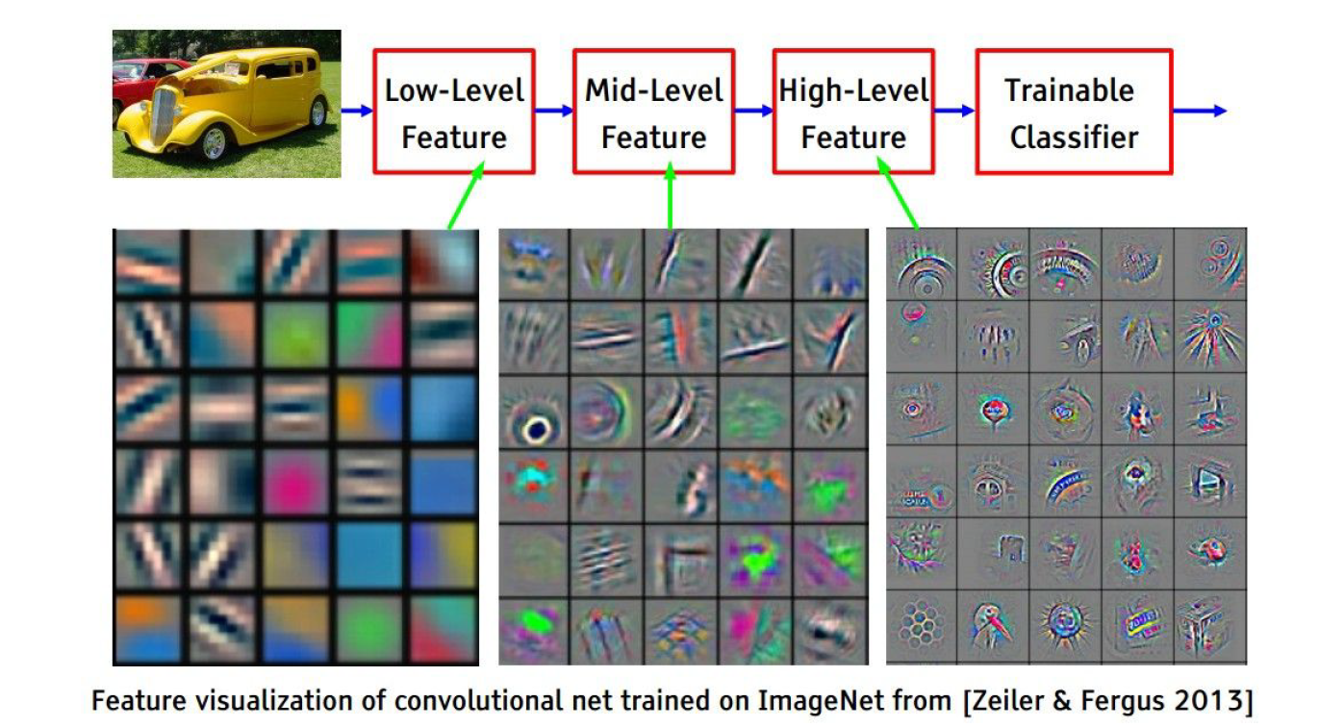
Transfer Learning: Reusing Models
Domain level summarization
(Text is one domain, image is another domain)
Category level summarization
(medical text is one category, stock text is another category)
Problem level summarization
(corona related text, cancer related text)
A pre-trained DL model has many useful features required to solve a completely new problem

Slide 15
03
Text Representations

Slide 16
How do we represent a text with numbers?
Character embeddings (60-70 embeddings)
a:1, b:2 etc.
Word embeddings (100,000-500,000 embeddings) (Word2Vec, Glove)
a:1, apple: 2…
Token embedding (30,000-60,000 embeddings) (sentence piece, tik token)
a:1, pp:2, le:3…
As the embedding size grows, the representation length gets smaller, and vice versa
Character embedding: 1, 22, 31, 4, 54, 42, 31, 26,7,….
Token embedding: 3125, 4235, 112

Slide 17
Deep learning in word embeddings
The manual embeddings are fed as inputs (one-hot encoded) into a neural network to predict the next word (language model)
The layer before the prediction is a good embedding of the word (remember feature creation!)
Limitation: Based on the context, meaning may change
I took my cell phone into the prison cell to meet the cell mates and collect their cell DNAs

Slide 18
04
Traditional Language Models

Slide 19
Language Model
Finding a word given a context
It is a glass of orange ______
The clouds are in the ______
LMs should be able to predict the word in the middle also

Slide 20
The context may not be simple
I met this French girl Emily in a conference last year. We fell in love instantly! My parents are conservative. So, I planned and organized a blind date with my parents. They loved her. My mother hugged me right after Emily left. Even my Dad gave that rare wink. I am so excited ☺ All that is left is to convince Emily’s parents. Here, I am booking my tickets to ____________

Slide 21
Is language model best set up as a generative or a discriminative problem?
Let us get into details of building a LLM

Slide 22
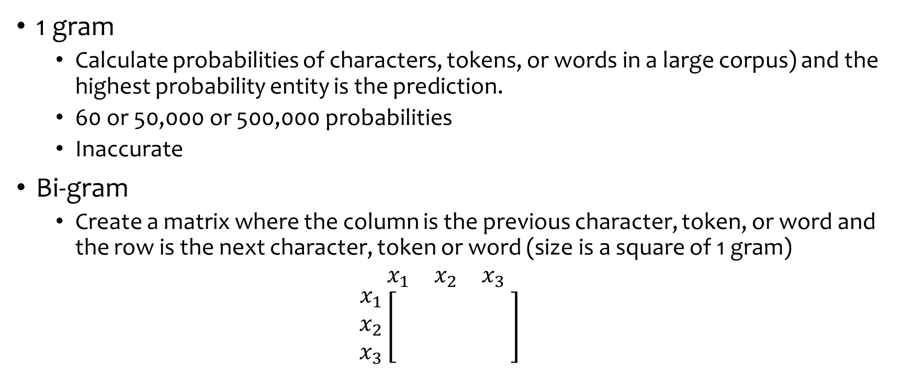
Language Models (1980s)
1 gram
Calculate probabilities of characters, tokens, or words in a large corpus) and the highest probability entity is the prediction.
60 or 50,000 or 500,000 probabilities
Inaccurate
Bi-gram
Create a matrix where the column is the previous character, token, or word and the row is the next character, token or word (size is a square of 1 gram)
$\begin{matrix}x_{1} & x_{2} & x_{3}\end{matrix}$
$$\begin{matrix}x_{1} \\ x_{2} \\ x_{3}\end{matrix}\left[\begin{matrix} & & \\ & & \\ & & \end{matrix}\right]$$

Slide 23




















Slide 24
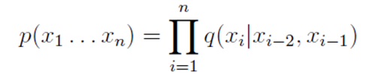
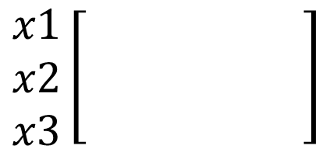
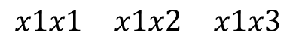
Tri-grams
$$\begin{matrix}x1x1 & x1x2 & x1x3\end{matrix}$$
$$\begin{matrix}x1 \\ x2 \\ x3\end{matrix}\left[\begin{matrix} & & \\ & & \\ & & \end{matrix}\right]$$
Transition probability matrix
Applications: Prediction of next word in a sequence
(p(w3|w2,w1) after measuring p(w1,w2|w3)
Size is cube of tri-gram

Slide 25
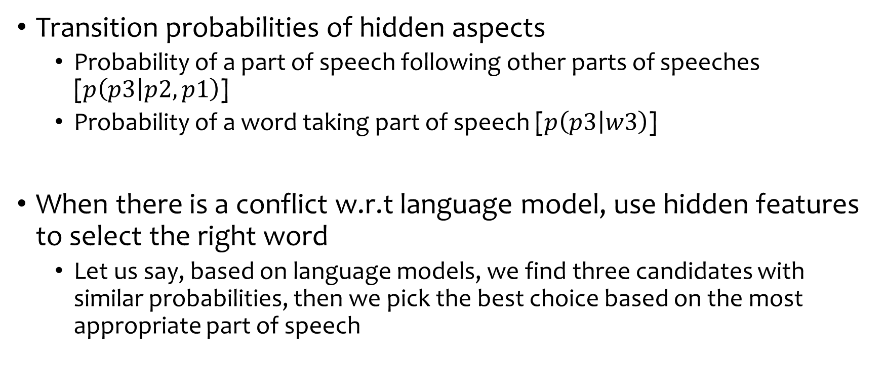
Enhancing accuracies with other features (HMMs) (still 1980s)
Transition probabilities of hidden aspects
Probability of a part of speech following other parts of speeches [$p\left(p3 | p2,p1\right)$]
Probability of a word taking part of speech [$p\left(p3 | w3\right)$]
When there is a conflict w.r.t language model, use hidden features to select the right word
Let us say, based on language models, we find three candidates with similar probabilities, then we pick the best choice based on the most appropriate part of speech

Slide 26
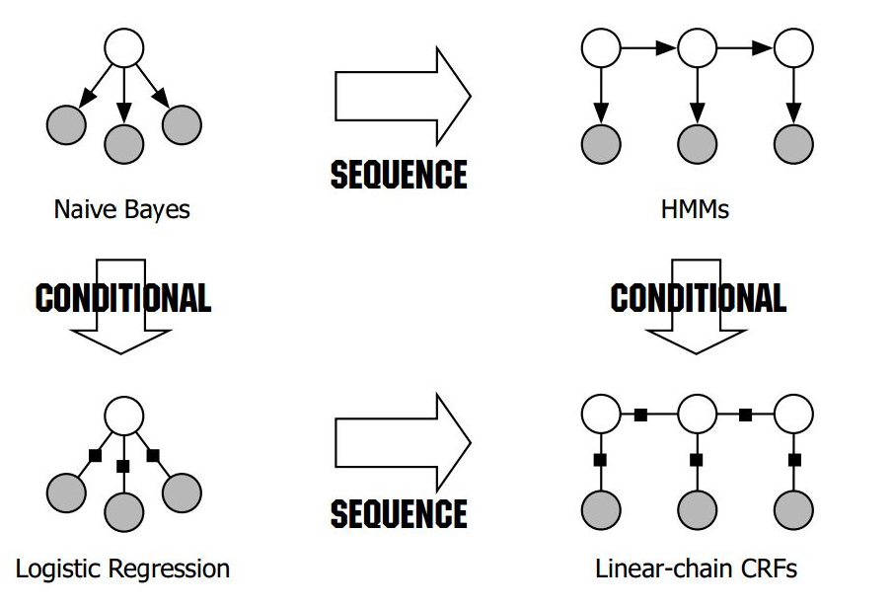
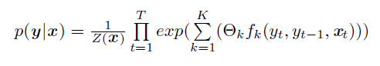
Conditional random forests (LMs of 2000s)
Hidden Markov models use only a limited set of sequential features (hence, limit to trigrams)
CRFs use all that HMMs use and allow us to add many more features
One can use any features

Slide 27
Traditional LMs by 2010
Build word transitions (trigram)
Build any hidden transitions (HMM trigrams)
Manually, identify as many features as you can
Combine all of them (conditional random field) and predict the most likely next word

Slide 28
05
Large Language Models
Neural (2010 to now)

Slide 29
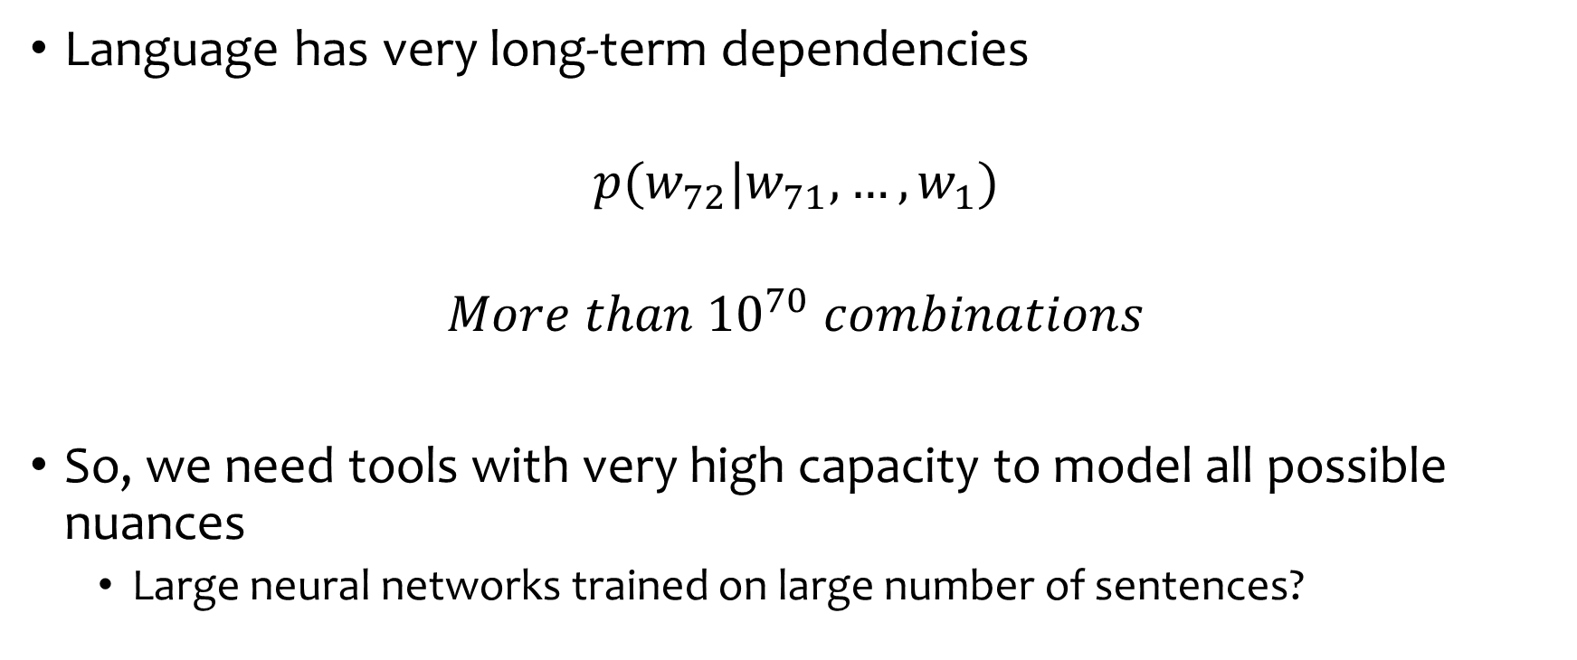
Why do the probabilistic models fail and how can we resolve?
Language has very long-term dependencies
$$p(w_{72}|w_{71},…,w_{1})$$
$$More than {10}^{70} combinations$$
So, we need tools with very high capacity to model all possible nuances
Large neural networks trained on large number of sentences?

Slide 30
Language Models: The Deep learning Way: LSTM
A meaningful set of features have to be extracted from a sentence
A time series variant of a neural network where every word’s impact is computed sequentially
Typically, you initialize the feature set with zeroes or a small noise added
https://stackoverflow.com/questions/49223976/default-initialization-for-tensorflow-lstm-states-and-weights

Slide 31
LSTMs
You decide to represent your features in as much detail as you want. Typically 1024 nodes etc.
Features/Cell state/Context/Memory/Embedding
tanh
Forget gate (outputs are sigmoids (mostly 0 to 1)
Learning Gate (outputs are 0 to 1)
What to add (outputs are -1 to 1 or RELU)
Gate (outputs are 0 to 1)
Input (green) is some type of word embedding

Slide 32
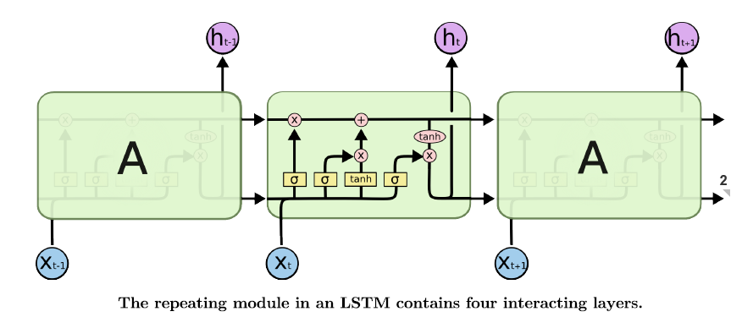
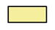
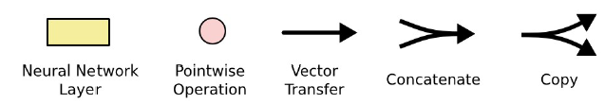
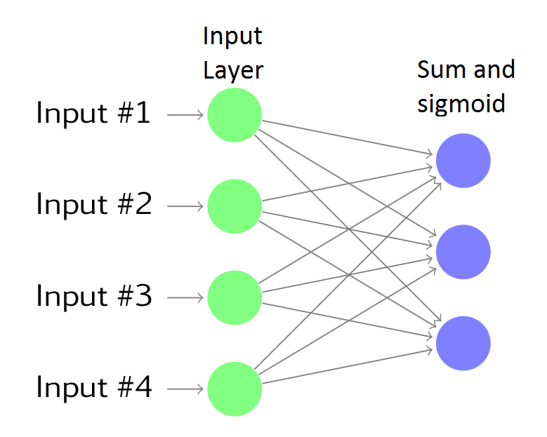
LSTM
Performance is unsatisfactory for large sentences

Slide 33
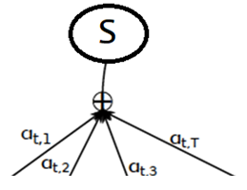
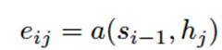
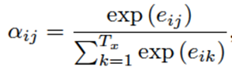
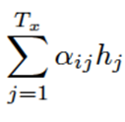
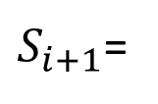
External input-based Attention
H1
H2
H3
H4
H1
H2
H3
H4
H1
H2
H3
H4
Attention is developed to figure out the importance of each input in the past to predict the next output
In step 1, compute the affinity of current state with each word
In step 2, convert the affinities into weights
$S_{i+1}$=

Slide 34
External input-based attention: Algorithm
Let each input vector (the encoding at each time step) be called k (key)
Let the hidden state in the output be called query (q)
The importance of that input for that query is determined by similarity between q and k.
Dot product is one way to get the similarity. A high value means higher similarity (that input token is more relevant for translation) and low value is lower similarity
Compute similarities with all the inputs at each output. Softmax them to convert into weights (probabilities) that add up to 1.
Weight the input encodings (this time it is called value, “v”) using these similarities and use for prediction

Slide 35
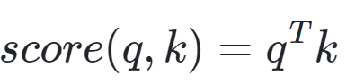
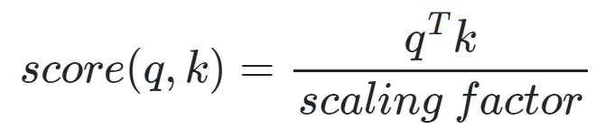
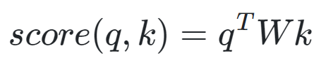
Computing the similarities
“a”can be computed in many ways
Dot product
Scaled dot product (as q and k dimensions go up dot product goes up). Scaling normalizes it.
Bi-Linear score has a learnable parameter W. This allows query and key to be different dimensions

Slide 36
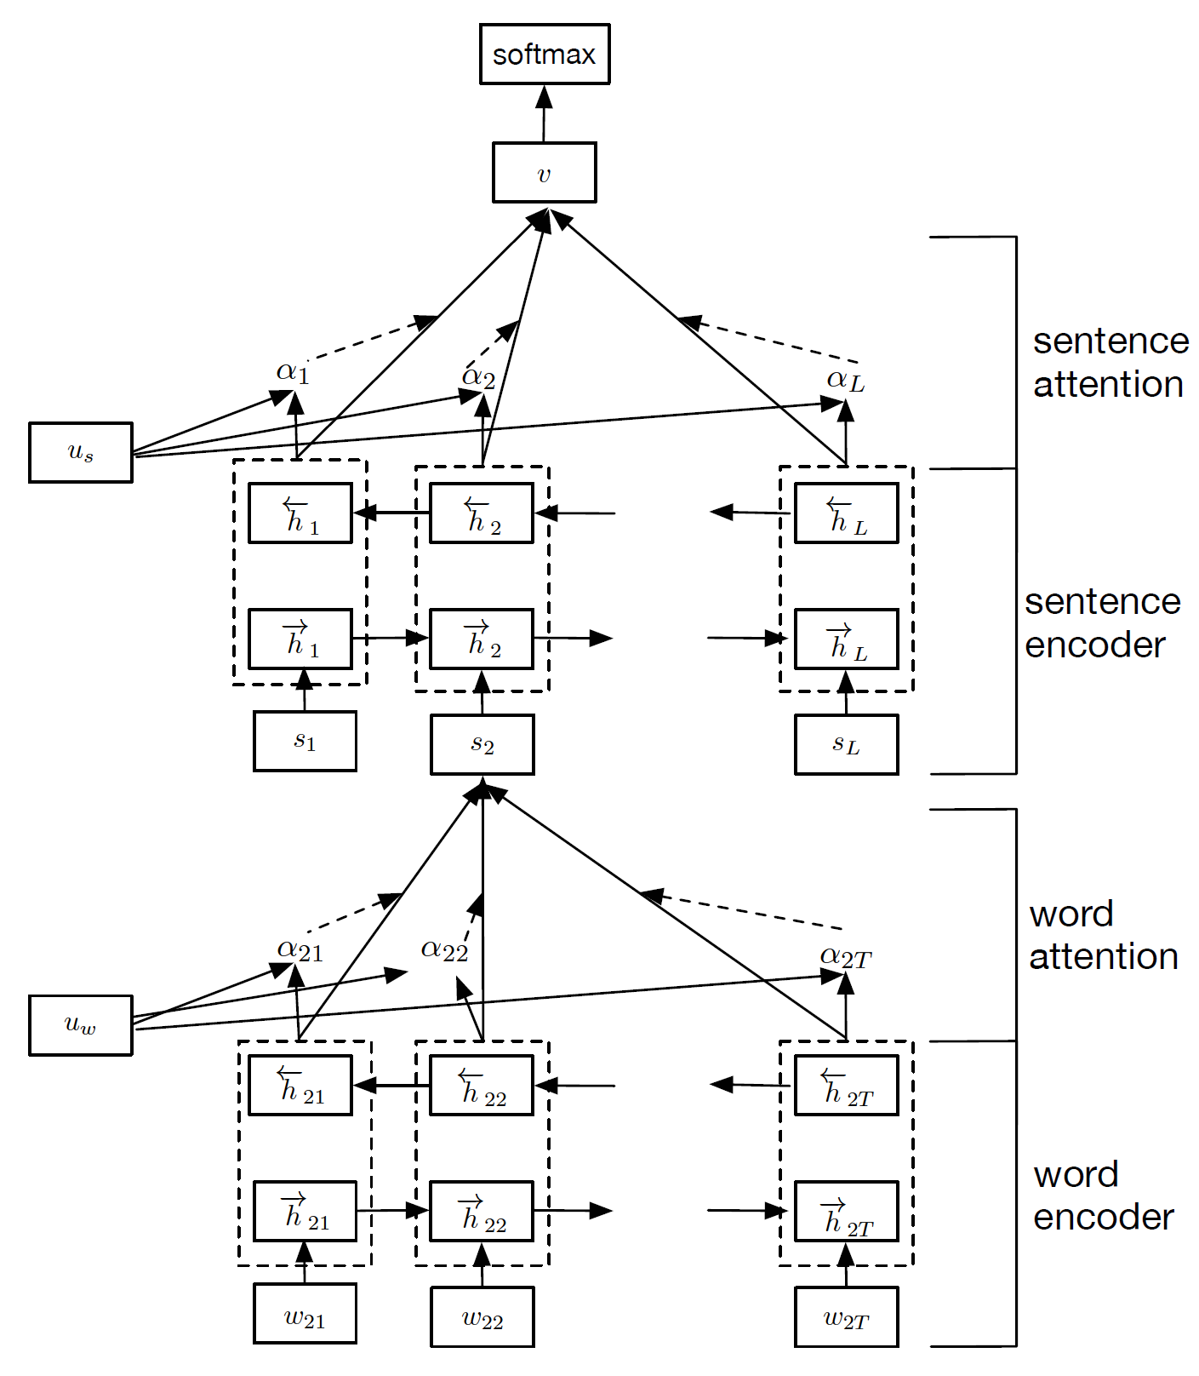
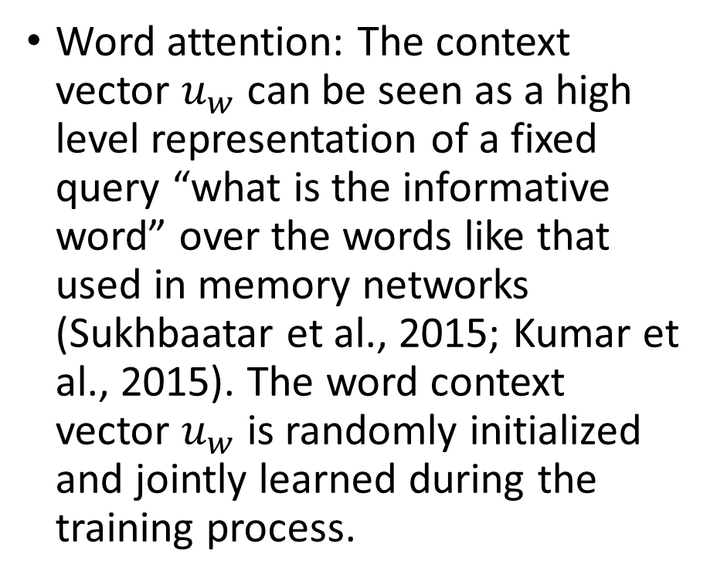
Hierarchical NN (Embed, Encode, Attend and Model)
Word attention: The context vector $u_{w}$ can be seen as a high level representation of a fixed query “what is the informative word” over the words like that used in memory networks (Sukhbaatar et al., 2015; Kumar et al., 2015). The word context vector $u_{w}$ is randomly initialized and jointly learned during the training process.

Slide 37
Causal or self attention
https://towardsdatascience.com/illustrated-self-attention-2d627e33b20a
A sentence looks at previous words (typical language models)
The query is the latest word generated
Keys and values are the previous words
We achieve this by making certain key weights very large negative values
Bi-directional self attention is where the word looks at both sides
Both are solved similarly with a simple masking trick (large negative value in upper triangular matrices) if forward looking is not allowed

Slide 38
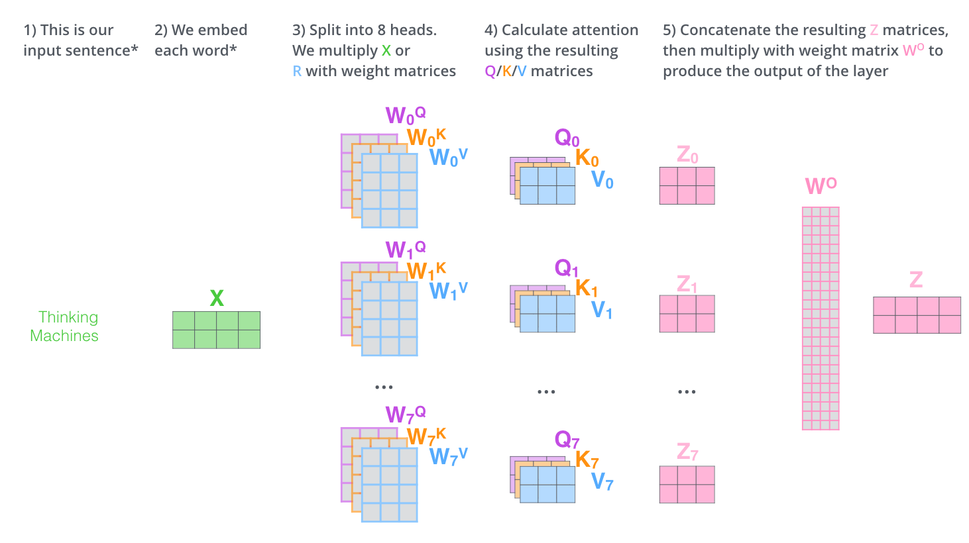
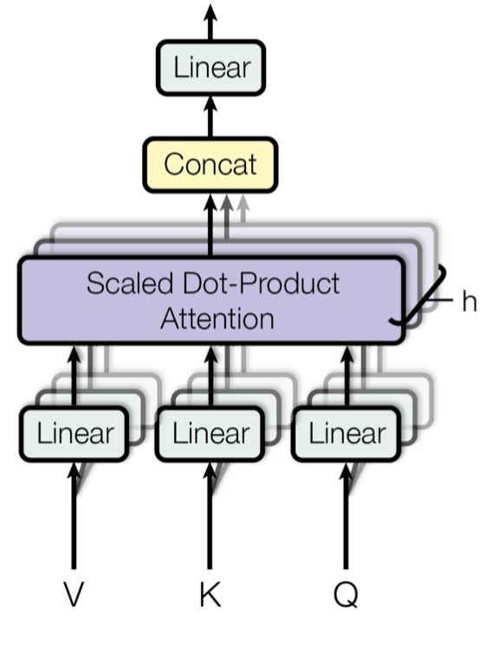
Multi-Head Attention
Words have multiple dependencies
A word may be similar to other based on meaning
Same word may be similar to some other word based on part of speech

Slide 39
06
STOA Language Models

Slide 40
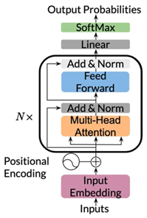


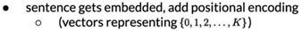

Transformer [(embed+attend+model)*n]

Slide 41
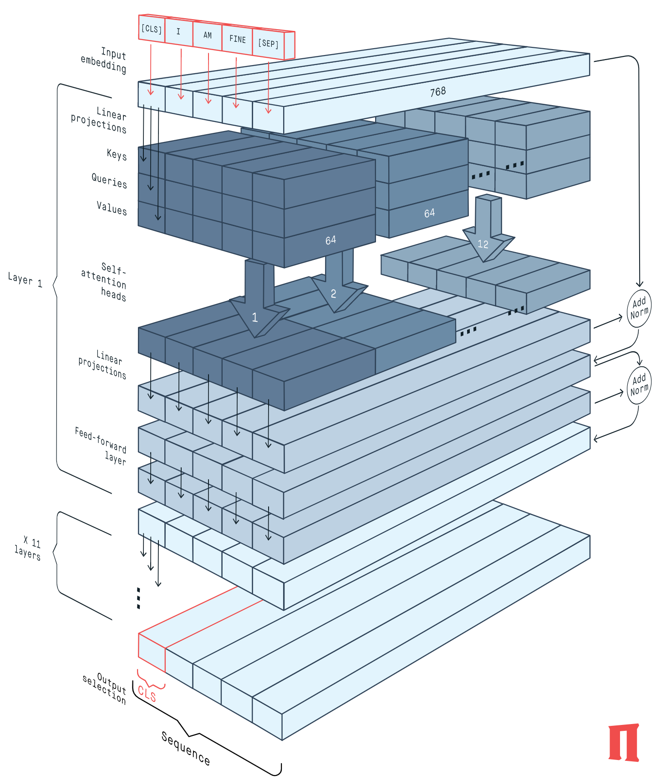
BERT (Bidirectional Encoder Representations from Transformers)
More layers mean more capacity and more data can be read
BERT Encoder (peltarion.com)
BERT Explained: What it is and how does it work?
The Illustrated BERT, ELMo, and co.
1810.04805.pdf (arxiv.org) (main BERT paper)

Slide 42
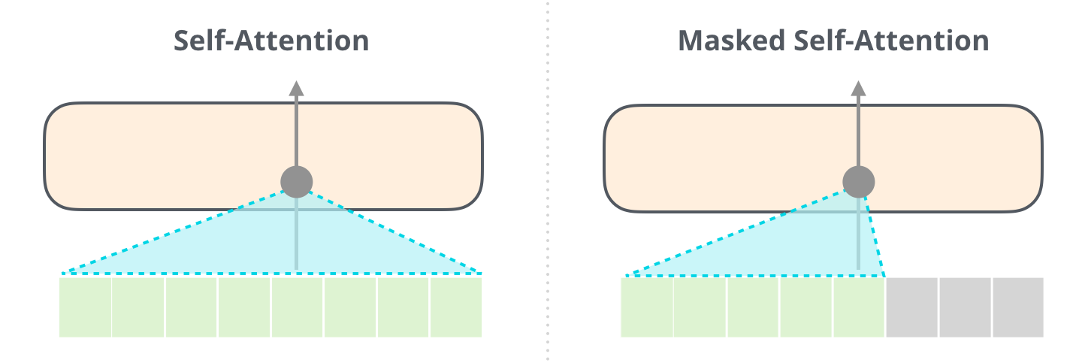
Decoder Architecture: masked self-attention
The Illustrated GPT-2 (Visualizing Transformer Language Models) – Jay Alammar – Visualizing machine learning one concept at a time. (jalammar.github.io)

Slide 43
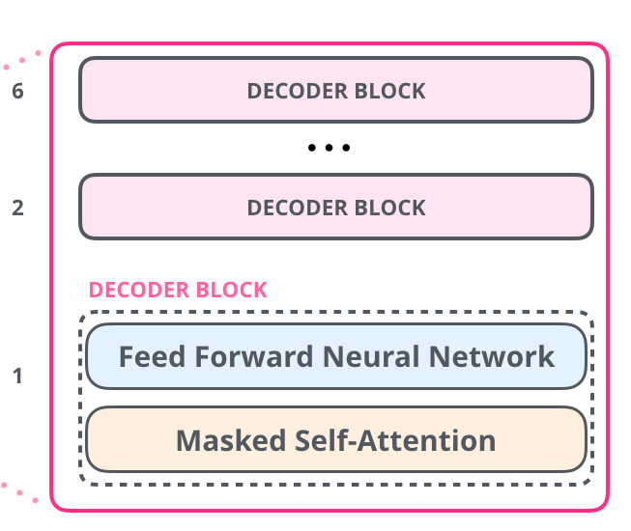
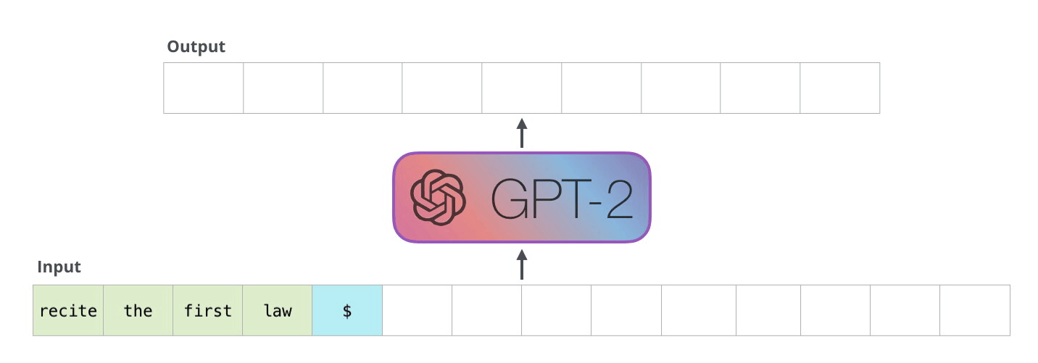
Masked self-attention demonstrated

Slide 44
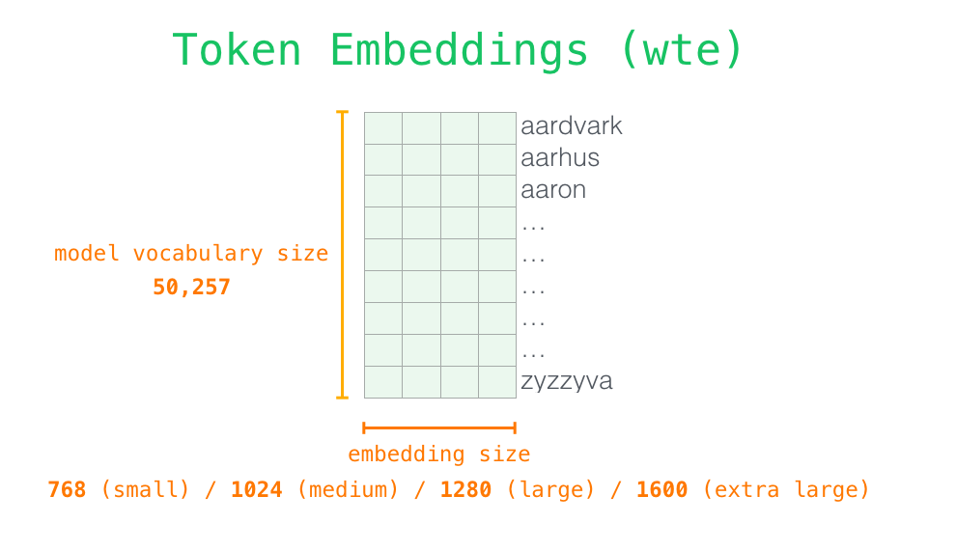
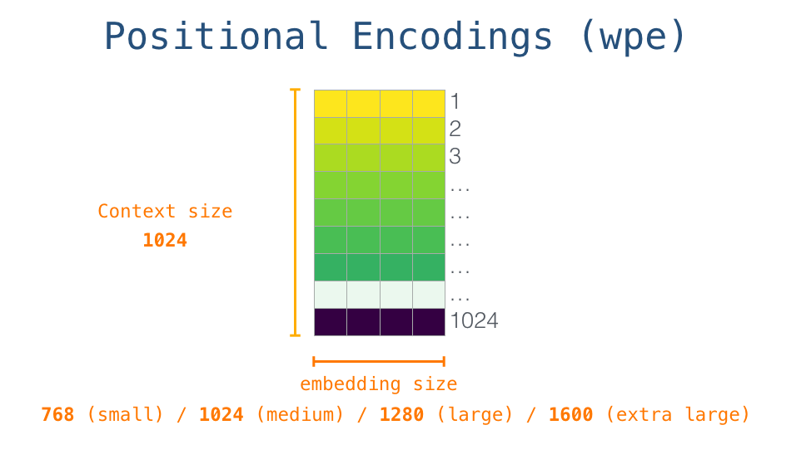
Inputs to Decoder Transformers

Slide 45
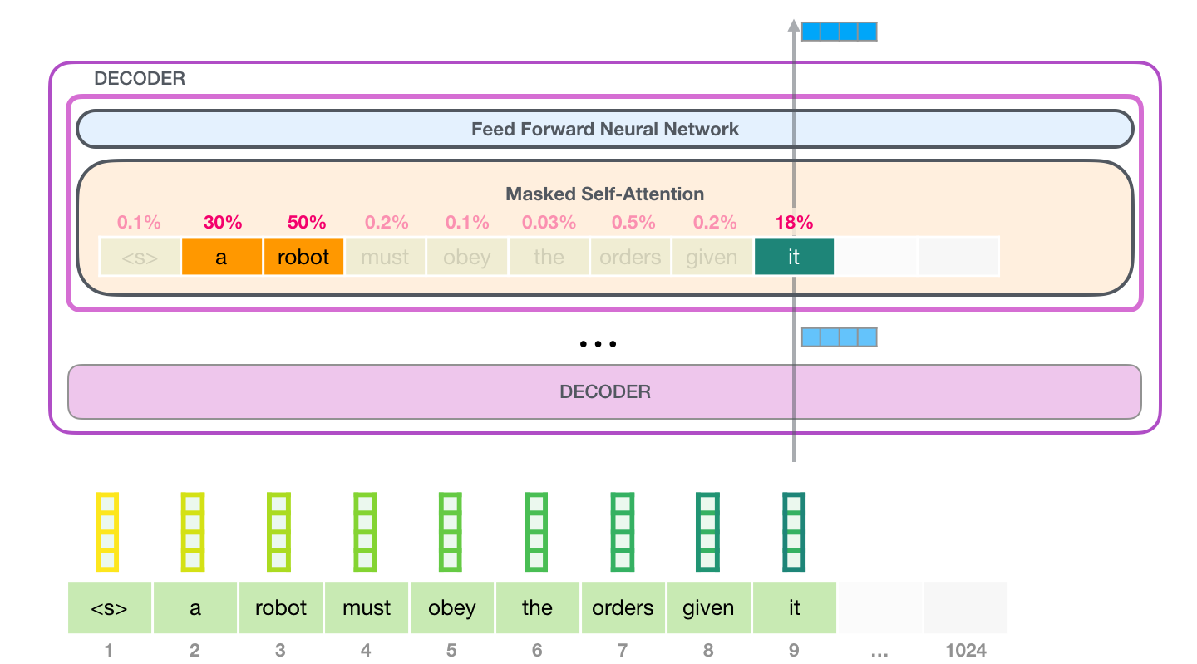
Operations in Decoder

Slide 46
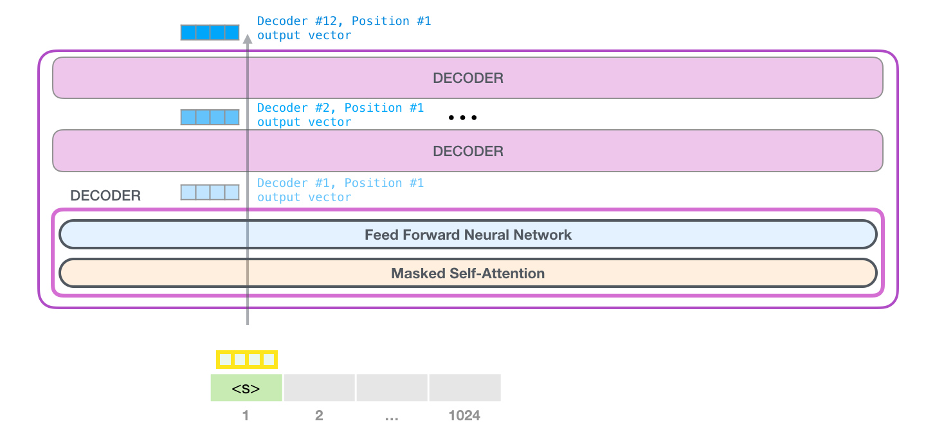
Process

Slide 47
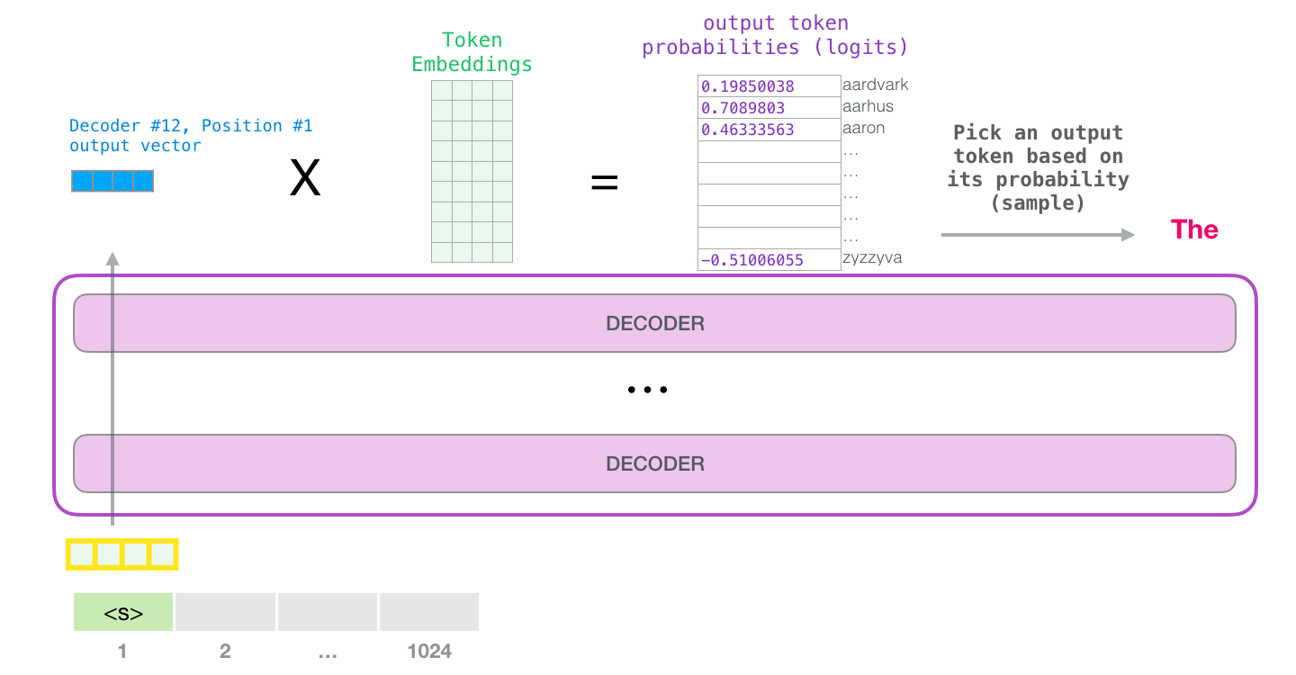
Last layer

Slide 48
07
ChatGPT refinements: Reinforcement Learning

Slide 49
The name of the country is the
United States of America
The name of that country is the United Kingdom of Great Britain and Northern Ireland
V/S
Both sentences are very different from each other.
If at any timestep, if the LM takes a wrong step, the final sentence will differ a lot from the target.

Slide 50
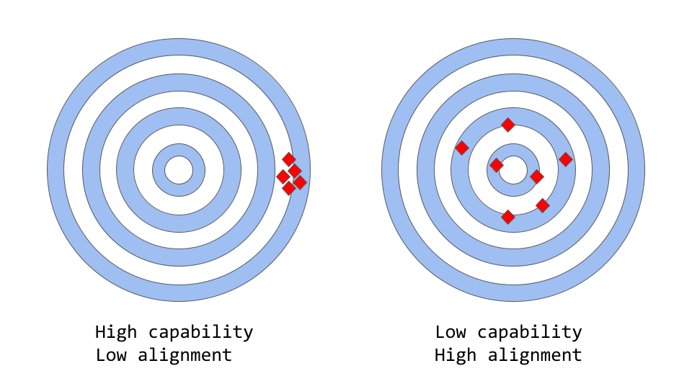
How ChatGPT actually works (assemblyai.com)
Models like the original GPT-3 are misaligned
A model which is only trained to predict the next word (or a masked word) in a text sequence, may not necessarily be learning some higher-level representations of its meaning. As a result, the model struggles to generalize to tasks or contexts that require a deeper understanding of language.

Slide 51
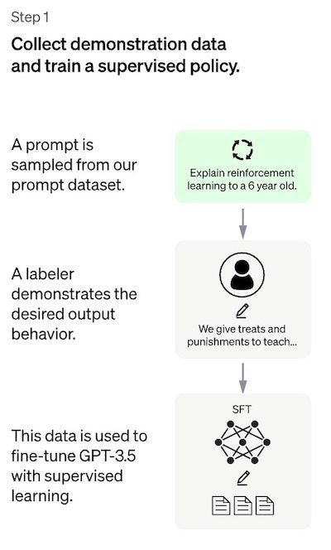
Resolution
The Supervised Fine-Tuning (SFT) model
A group of human labelers are asked to write down the expected output for a list of prompts. As this process is slow and expensive, the result is a relatively small, high-quality curated dataset (of approximately 12-15k data points, presumably) that is to be used to fine-tune a pre-trained language model.
A GPT-3 model which was fine-tuned mostly on programming code was used as a baseline model. Therefore, in order to create a general-purpose chatbot like ChatGPT, the developers decided to fine-tune on top of a “code model” rather than a pure text model.
This still will have low alignment as the training data is small

Slide 52
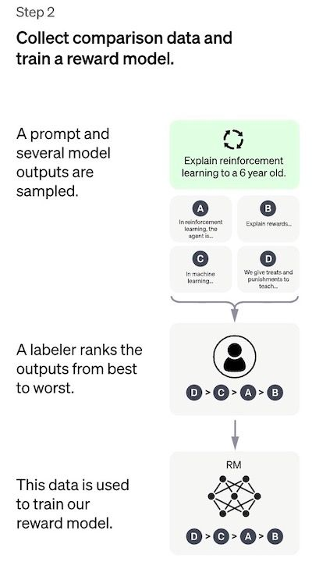
Resolution
The reward model
A list of prompts is selected and the SFT model generates multiple outputs (anywhere between 4 and 9) for each prompt.
Labelers rank the outputs from best to worst. The result is a new labeled dataset, where the rankings are the labels. The size of this dataset is approximately 10 times bigger than the curated dataset used for the SFT model.
This new data is used to train a reward model (RM). This model takes as input a few of the SFT model outputs and ranks them in order of preference.

Slide 53
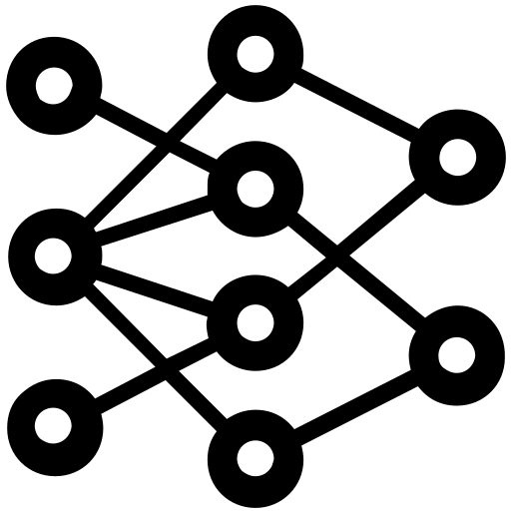
REINFORCEMENT LEARNING
Feedback
Candidates
Prompt
I went to the financial
bank to deposit money
restaurant to eat money
department to apply for a loan
market to buy some food
A human checks which of the candidates are better and ranks them accordingly
The goal is to learn an objective function (the reward model) directly from the data. The purpose of this function is to give a score to the model outputs, proportional to how desirable these outputs are for humans.

Slide 54

REINFORCEMENT LEARNING
Prompt
Candidates
Feedback
I went to the financial
bank to deposit money
Reward model
I went to the financial
restaurant to eat money
I went to the financial
department to apply for a loan
I went to the financial
market to buy some food
Another reward model is trained using the inputs(Prompt & candidates) & outputs(feedback)

Slide 55
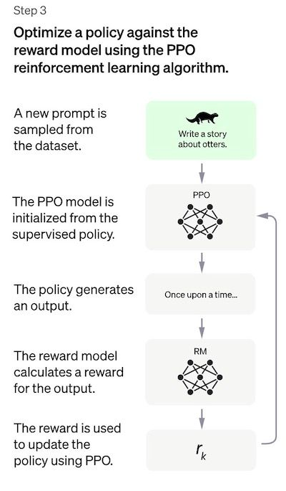
Reinforcement Learning
The preferences of the labelers who produce the demonstration data.
The researchers who design the study and write the labeling instructions.
The choice of prompts crafted by the developers or provided by the OpenAI customers.
The labeler’s bias is both included in the reward model training (by ranking outputs) and in the model evaluation.

Slide 56


REINFORCEMENT LEARNING
Policy update
Tuned LM
Reward model
Produces reward for the generated text
Prompt:
A dog is
a man’s best friend

Slide 57
EVOLUTION OF LANGUAGE MODELS
Megatron-Turing-NLG(530B)
1000B
GPT-3(175B)
PaLM(540B)
100B
Jurasic-1(178B)
Megatron-LM(8.3B)
10B
Turing-NLG(17.2B)
T5(11B)
1B
GPT-2(1.5B)
0.1B
BERT-Large(340M)
ELMo(94M)
0.01B
2018
2019
2020
2021
2022
2023

Slide 58
Here are some examples of organisations using LLMs to build AI-enabled apps:
Khan Academy developed “Khanmigo”, a ChatGPT-based teaching assistant that offers 1:1 tutoring support to students:
At upGrad, we are developing a personalised interview-preparation assistant.
CheggMate: https://www.chegg.com/cheggmate
Khanmigo: https://www.khanacademy.org/khan-labs
Einstein GPT Salesforce: https://www.salesforce.com/news/press-releases/2023/03/07/einstein-generative-ai/
Microsoft Copilot: https://blogs.microsoft.com/blog/2023/03/16/introducing-microsoft-365-copilot-your-copilot-for-work/
Canva AI Text to Images: https://www.canva.com/?highlight=textToImage
Bing Image Creator: https://www.bing.com/images/create/a-train-riding-a-wave/645250c529aa41768fcb7f6a7ec51f48?FORM=GENCRE

